Slide 1

Emma Jane Heneghan
Alexei Suleac

Slide 2

Overview of Presentation
Application Objective
Users of the Application
Hierarchical Structure
Visual Design
Database Design
XML
Technologies and Techniques Used
Maintenance
SEO
Strengths and Weaknesses

Slide 3
Application Objective
Provide Information
Provide management tools
Help with organisation

Slide 4
Users of the Application
General public
Players or members
Coach
Admin

Slide 5
Hierarchical Structure
Home Page
About Us page
Results and Fixtures
Team Profiles
Pitch info
Join Us
Contact Us
Gallery
Admin, Coach and members specific pages

Slide 6
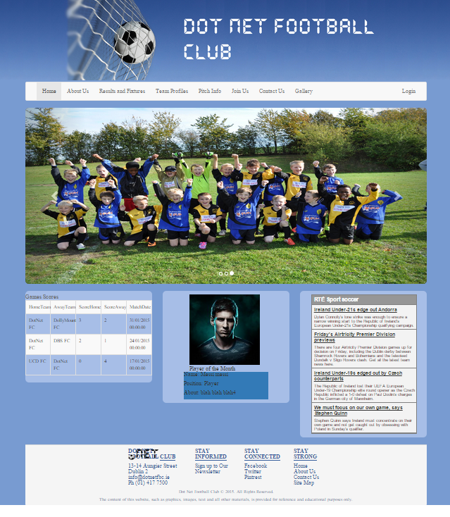
Visual Design
Consistent
Two column layout
Colour scheme consistent

Slide 7
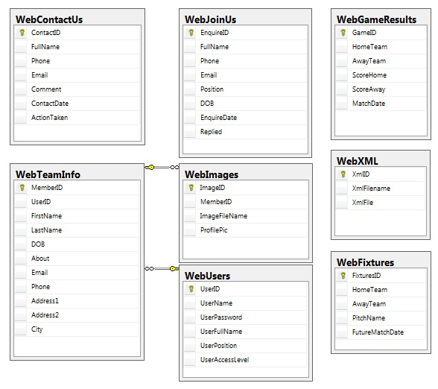
Database Design

Slide 8
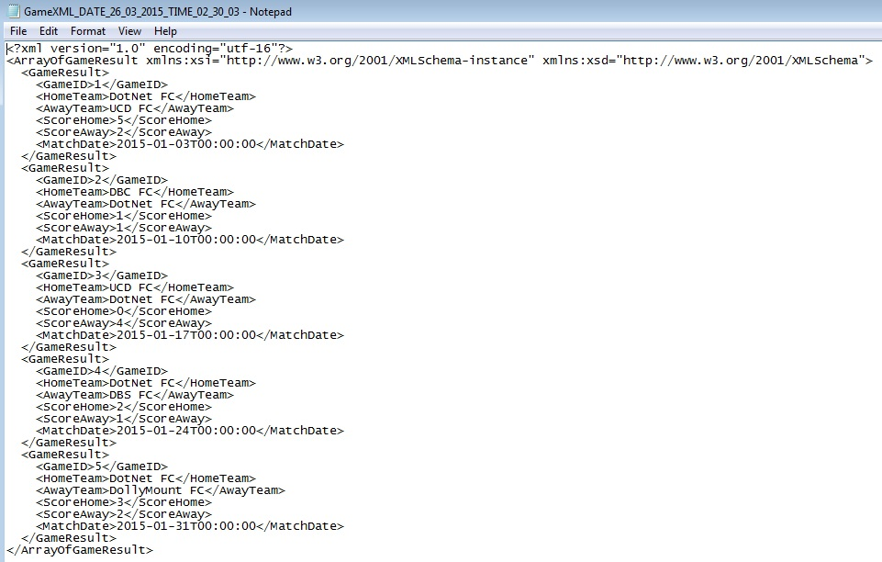
XML

Slide 9
Technologies and Techniques Used
HTML
CSS
JavaScript
JQUERY
ASP.NET
C#
JSON – AJAX enabled web service
Entity Frameworks

Slide 10
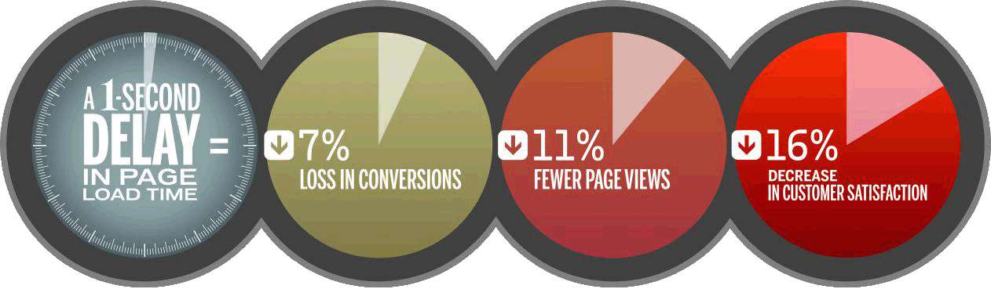



Maintenance
Performance
Security

Slide 11
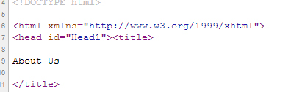


Search Engine Optimisation
Accurate Titles
Unique meta description
Good file structure
Clear URLs
Including a SiteMap
Relevant and Up to Date Information

Slide 12
Strengths and Weaknesses
Strengths:
Good Design
Appropriate levels of access for different user
Does what is required
Weaknesses
XML creation
XML sitemap
User can upload any size of images
Need more functionality for Admins

Slide 13

Conclusion

